Slide 1
How Sensitive are Model Calibration Reports to Input Data Error?
Craig Gresham, P.E.
Clearbox Forecast Group, PLLC
Wednesday, November 5th
North Carolina Model Users Group

Slide 2
Presentation Outline
Background
Typical Calibration Reports
When Good Data Goes Bad
Scramble Some Data!
Results
PDHs and a Cookie

Slide 3


Background
Once upon a time…….
R-Squared – Awesome
RMSE – Awesome
Model vs Counts – Awesome
Joining and copying TAZ data by ArcGIS ID instead of TAZ ID….. Not awesome
So how did the results look good when the input data was NOT in the right TAZs?

Slide 4
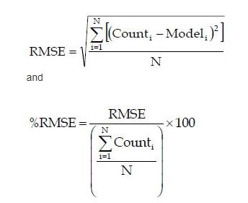
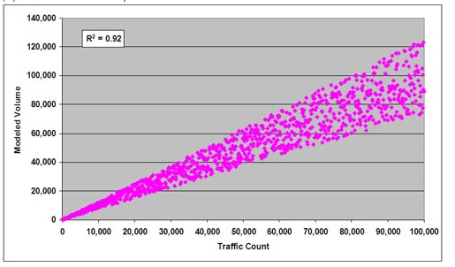
Typical Calibration Reports
Aggregate Data Versus Counts – (Sum of Volumes/Sum of Counts – 1)
  Usually presented by volume group and facility type
R-Squared (Correlation Coefficient)
% Root Mean Squared Error
Screenlines and Cutlines
Scatterplots

Slide 5


My only TDM Joke…..
WE GOT HIM!!!

Slide 6

What Happens when Good data goes Bad?
Given the reliance on model calibration reports to prove the effectiveness and quality of a TDM
What happens when the input data is bad? Like, really bad?
Academic Exercise –
  Take a calibrated travel demand model
  “Scramble” different inputs (keeping same totals)
  Rerun the model and calibration reports
  See what happens?

Slide 7
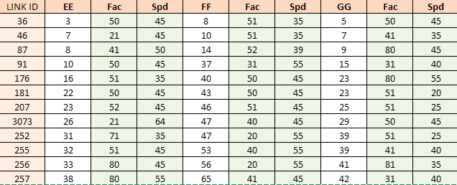
Data Scramble….
Household Data
Employment Data
Internal-External Data
Speed and Facility Type
  Ran TDM 10 times with each assigned to random TAZ/link and ran calibration report
  Everything else stayed as calibrated
  Overall totals remained constant (households, employees, etc.)

Slide 8
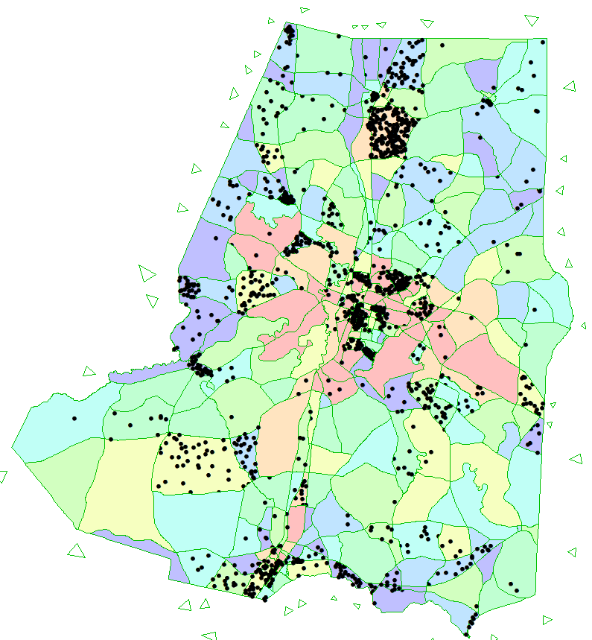
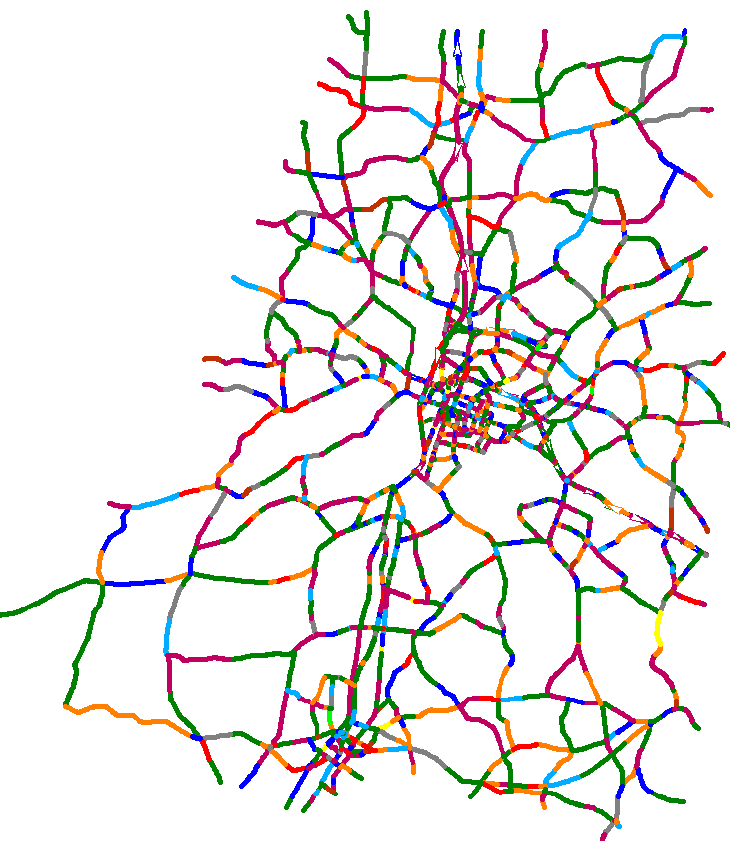
Data Scramble….
Employment Locations Facility Type

Slide 9
RESULTS

Slide 10
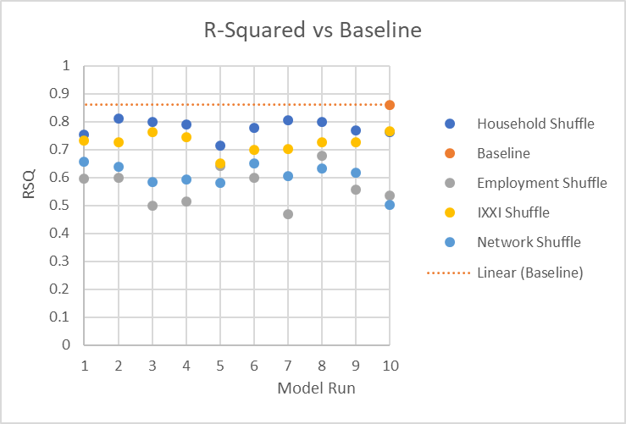
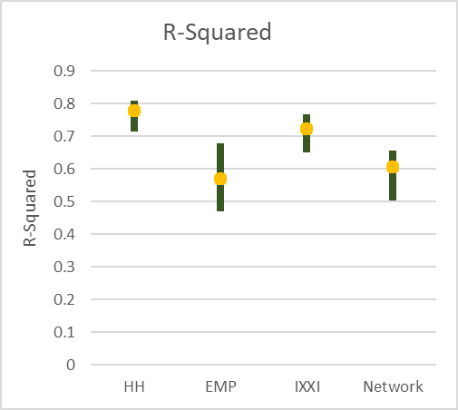
R-Squared

Slide 11
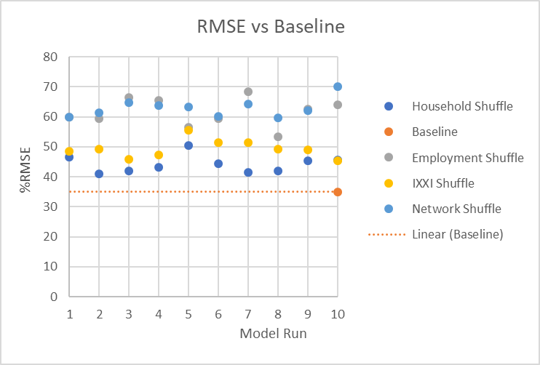
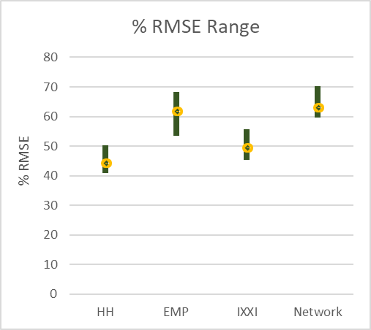
RMSE

Slide 12
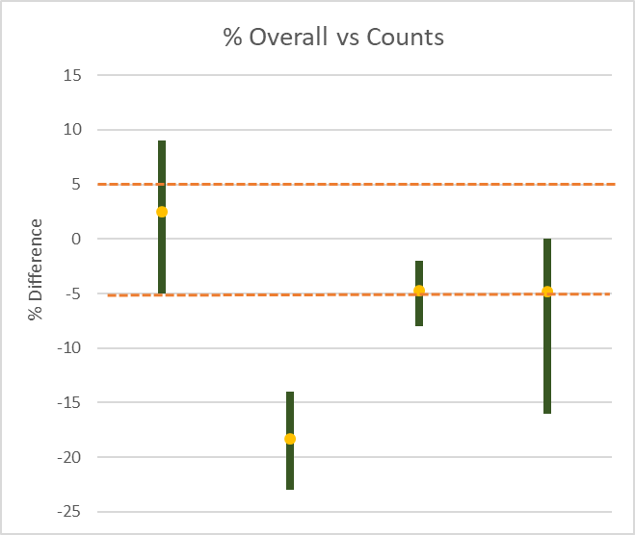
Volume vs Counts - Overall
HH EMP IXXI NETWORK

Slide 13
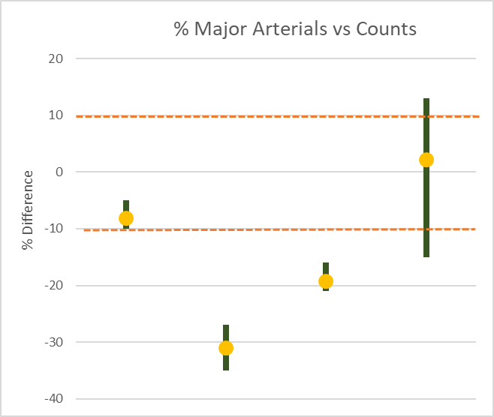
Volume vs Counts - Arterials
HH EMP IXXI NETWORK

Slide 14
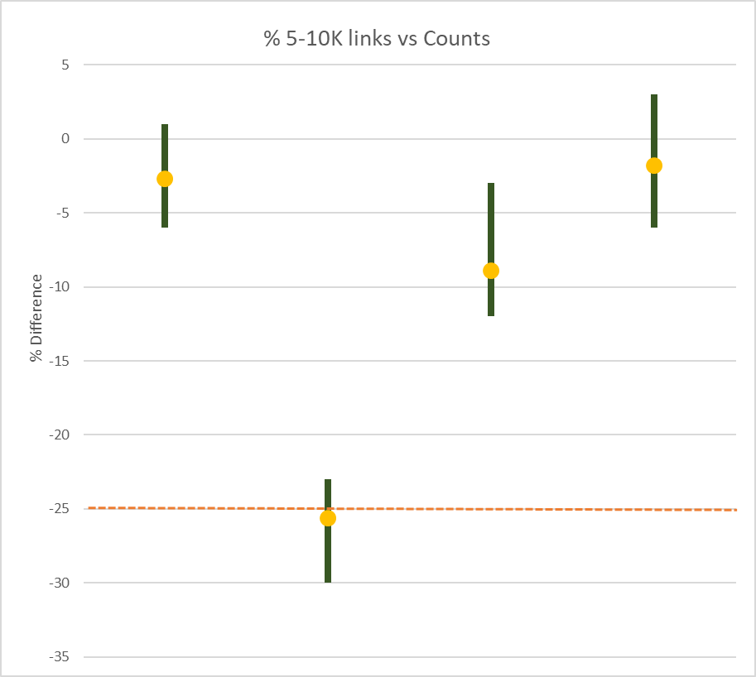
Volume vs Counts – 5,000 – 10,000 vehicles
HH EMP IXXI NETWORK

Slide 15
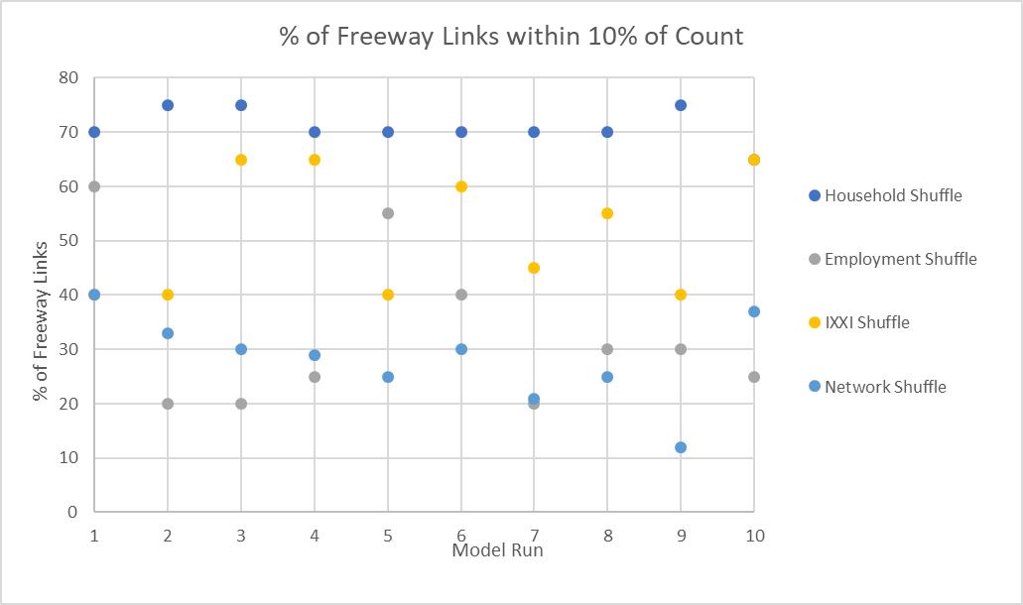
% of Freeways within 10% of Count

Slide 16
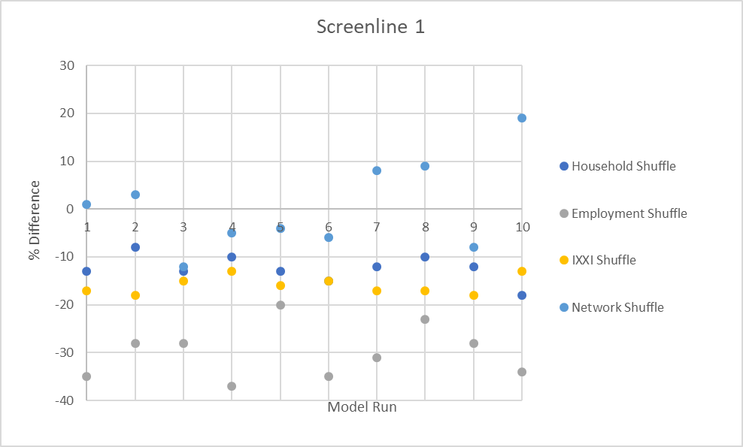
Screenline 1

Slide 17
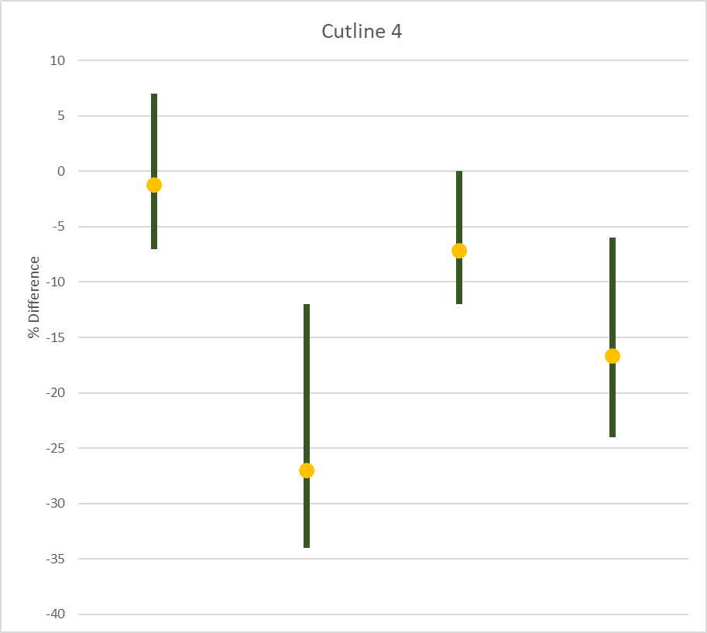
Cutline 4
HH EMP IXXI NETWORK

Slide 18
Observations
  Aggregate Observations can really mask errors
  RMSE and % of links within a particular count range were most effective
  Not much Household Location Sensitivity
  Employment Sensitivity – Yes!
  Screenlines and Cutlines more useful as Trip Distribution measures?

Slide 19
What do you think?
  Are our calibration standards good enough?
  Do aggregate calibration measures serve any purpose?
  Do we need a more standardized set of calibration parameters?
  Other ways to QC input data?

Slide 20
Contact Information
  Craig Gresham, P.E.
  Clearbox Forecast Group
  craig@clearboxforecast.com
  919-651-8010
  Special Thanks to:
  Maverick
  Walter White
  Diet Mountain Dew
  Calendars for Dummies

